Slide 1

Introduction to machine learning and basic machine learning models

Slide 2


List Of Contents
Intoduction
How machine learning works
Problems that can be solved using machine learning
Scikit-learn for ML
Studying Iris data set
Build our first model
k-nearest neighbors
Evaluation of model
4
7. Dicussion,Conclusion and Refrences

Slide 3
What exactly is machine learning?
Machine learning models learn from data and learn accordingly.
ML models find patterns in data and make predictions or decisions based on those patterns.
7. Dicussion,Conclusion and Refrences

Slide 4
How ML is better than traditional programming?
It enables computers to learn from data and improve their performance on a specific task without being explicitly programmed.
Numerous if-else conditions for student performance is not programmer friendly
4
7. Dicussion,Conclusion and Refrences

Slide 5
Predicting House Prices:
Imagine you have a dataset of houses that includes features like:
Size of the house (in square feet)
Number of bedrooms
Location
4
7. Dicussion,Conclusion and Refrences

Slide 6
Important terms in ML:
Features: Individual properties used as input to train the machine learning model. Example of features in House Price prediction model:
Area of house, no of bedrooms, distance from nearest market etc.
4
7. Dicussion,Conclusion and Refrences

Slide 7
Labels: They are the outcomes or outputs the model is trying to predict.
Labels help train the data in supervised learning so that predictions can be made on unseen data.
Example:
“Prices of house”
“score of student”
4
7. Dicussion,Conclusion and Refrences

Slide 8
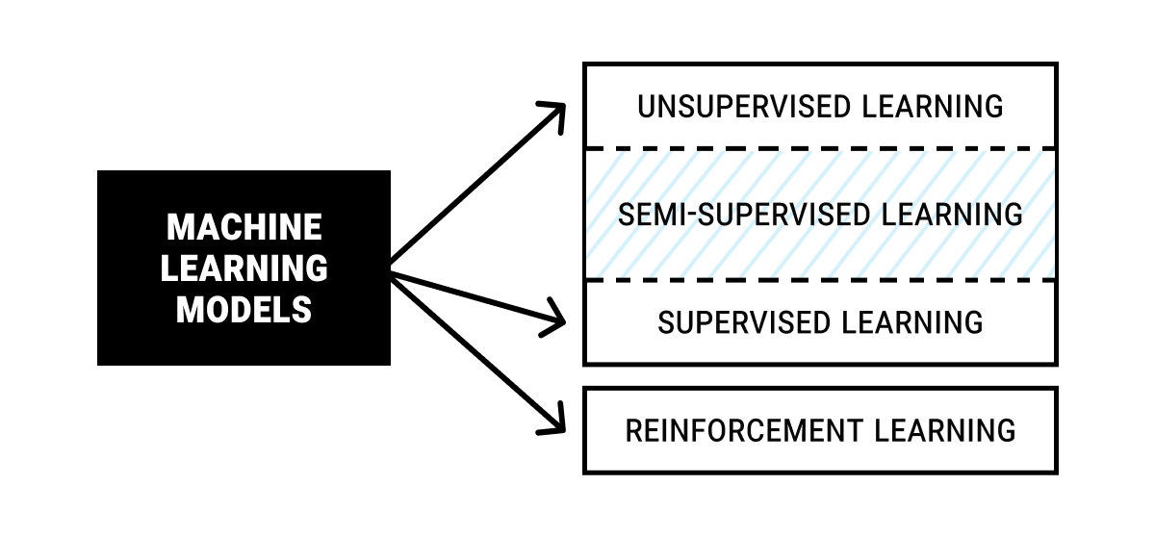
4
7. Dicussion,Conclusion and Refrences

Slide 9
Supervised ML model:
It is a type of machine learning where the model is trained using a labeled dataset. This means that the data includes both the input (features) and the correct output (label), so the model learns to map inputs to outputs.
7. Dicussion,Conclusion and Refrences

Slide 10
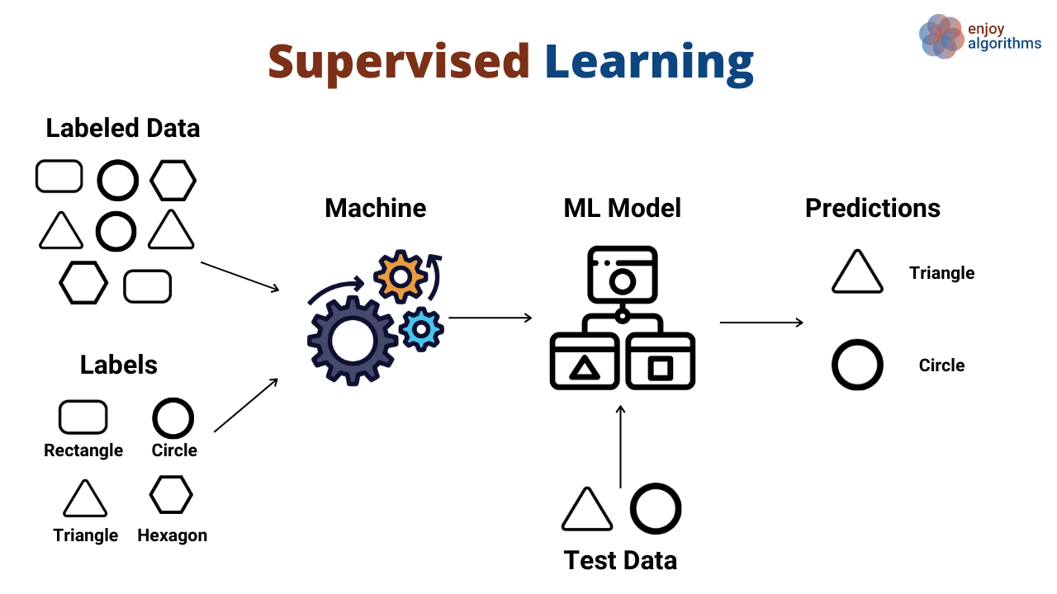
7. Dicussion,Conclusion and Refrences

Slide 11
Email 1: "Free money now" → Label: Spam
Email 2: "Meeting at 2 PM" → Label: Not Spam
7. Dicussion,Conclusion and Refrences

Slide 12
Unsupervised ML:
It is a type of machine learning where the model is trained on data that doesn't have labels. The goal is to find patterns, structures, or groupings in the data without being told what to look for.
7. Dicussion,Conclusion and Refrences

Slide 13
Clustering on the basis of similaritis is a common technique in unsupervised learning:
Grouping of images in gallery
7. Dicussion,Conclusion and Refrences

Slide 14
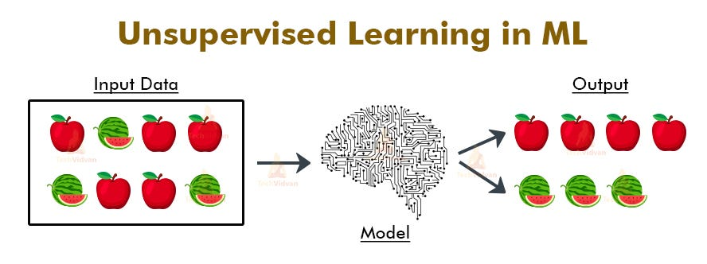
7. Dicussion,Conclusion and Refrences

Slide 15
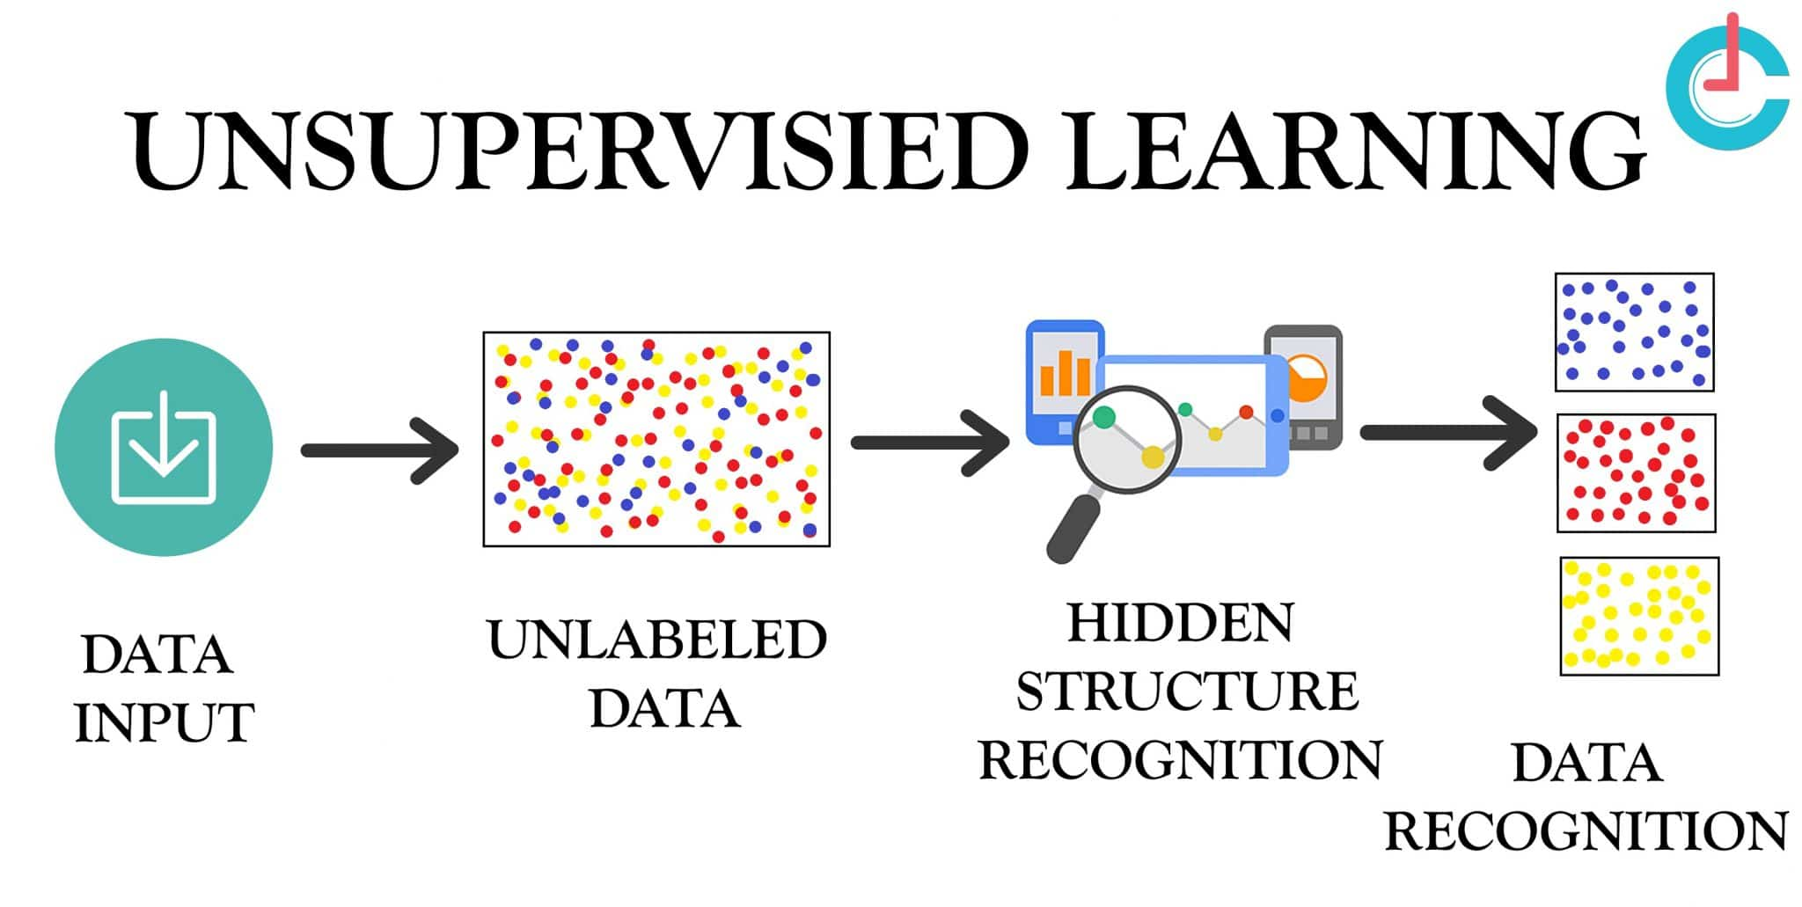
7. Dicussion,Conclusion and Refrences

Slide 16
Two types of ML models:
1- classification Models:
Predict catagories.
Spam vs non spam msgs
Disease diagnosis(malignant vs benign tumors)
7. Dicussion,Conclusion and Refrences

Slide 17
Two types of ML models:
2- Regression Models:
Predict continuous numeric values
Predicting house prices
Estimating sales profits
7. Dicussion,Conclusion and Refrences

Slide 18
Widely used ML models:
K-nearest models
Linear Regression
Logistic Regression
Decision Tree
7. Dicussion,Conclusion and Refrences

Slide 19
Sci-kit learn:
It is very prominent and famour library for machine learning. Has many useful algorithms for AI as well as very active user community.
!pip install scikit-learn
7. Dicussion,Conclusion and Refrences

Slide 20
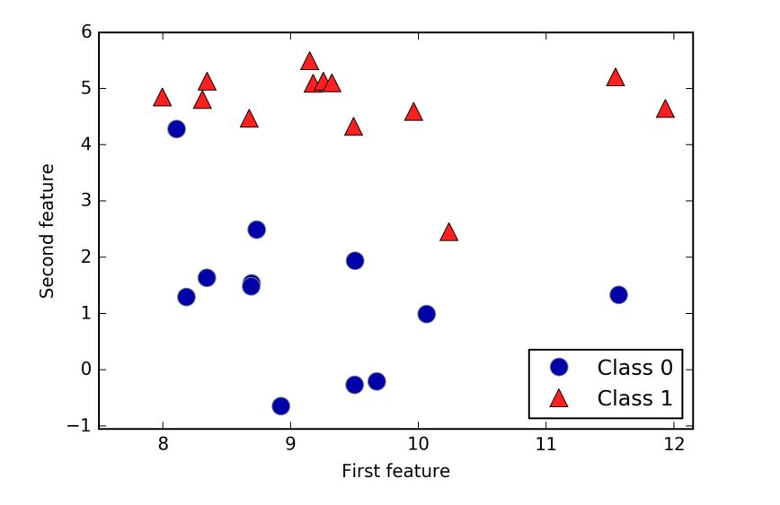
7. Dicussion,Conclusion and Refrences

Slide 21
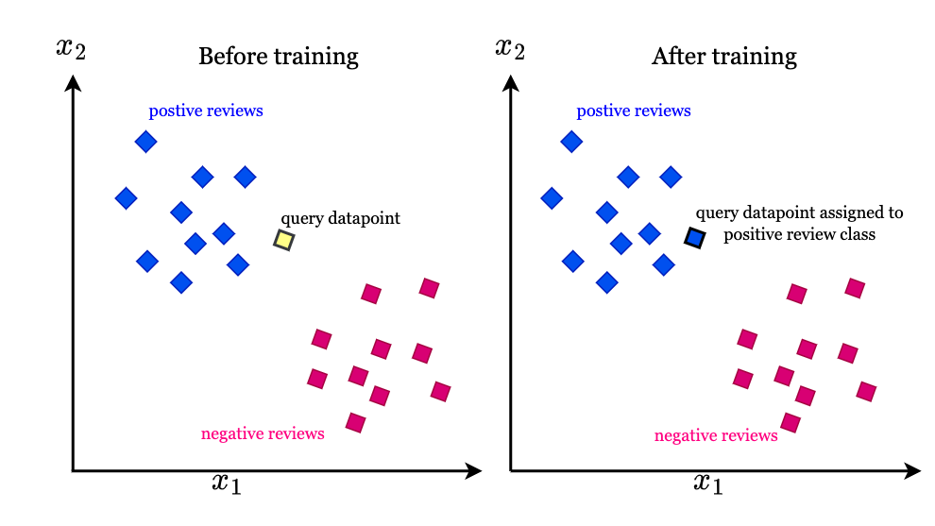
7. Dicussion,Conclusion and Refrences

Slide 22
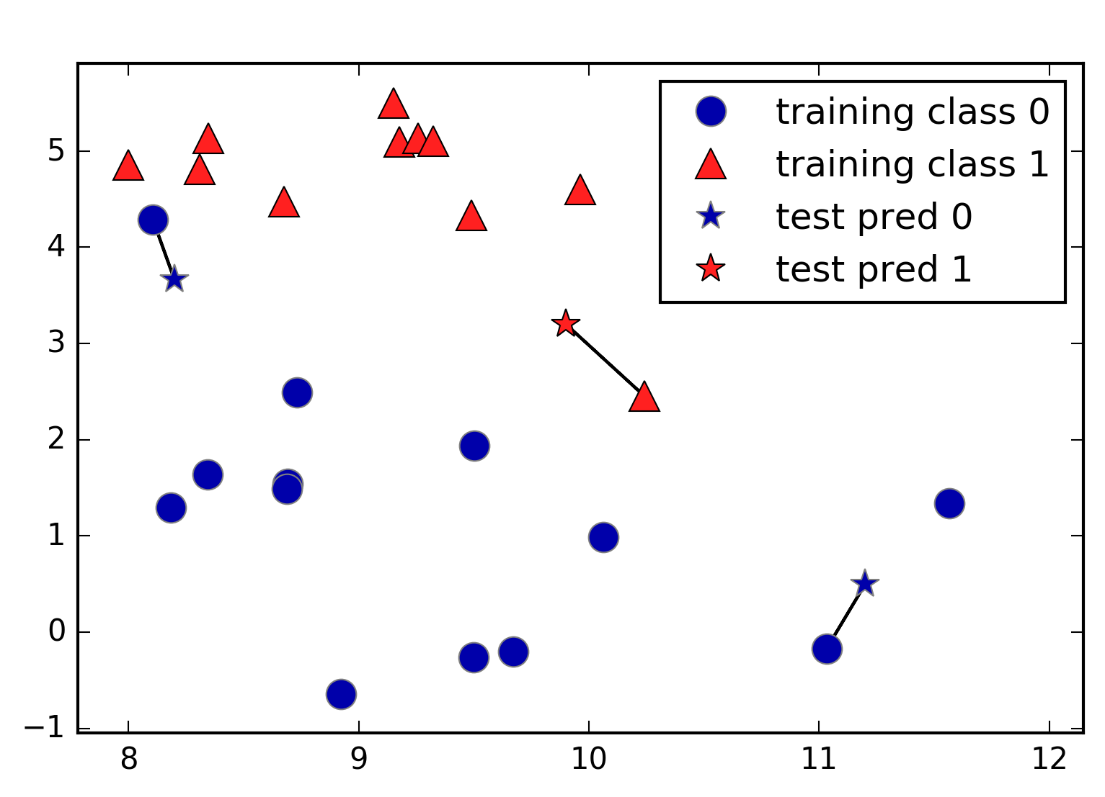

Slide 23
